Slide 1

User Habits & Trends – An analysis of how TRICS is used
Ian Coles, Operations Manager, Trics consortium ltd
Notes:
In this presentation I am going to tell you a bit about how the team at TRICS can monitor the usage of the system.

Slide 2
User Habits & Trends
Monitoring system allows the TRICS team to identify usage trends, such as:
Log Ins and user session durations
Trends in the analysis of different land use types
Use of the Help facility, Library and the Good Practice Guide
Notes:
We have a system in place which allows us to undertake analyses of user habits and trends. This is important to us, as it allows us to understand areas of the database that are most often used, and how this can change over time. Some of the things we can monitor include login and user session activity. The system records every login, and can provide us with an average user session duration. This kind of information can also be useful for monitoring the server on which TRICS runs online. We can also look at trends in the analysis of different land use types (in terms of the number of times categories are accessed and trip rates are calculated), and we can see how frequently our users access additional features of TRICS such as the Help facility, the Library module and the ever-important Good Practice Guide.

Slide 3
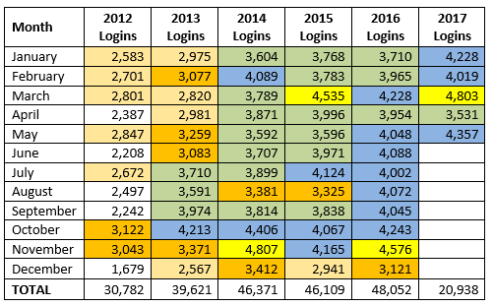
User Logins by Month: 2012 - 2017
Notes:
One of the most useful parts of our monitoring system is the recording of system login activity. Every time a user logs on to TRICS a session is recorded, and we have been monitoring the use of TRICS for a number of years now. Have a look at this table, colour-coded by level of use. The important colour here is the blue shade, which is the highest range of logins. As you will see, starting in 2012, we have monitored logins month by month continuously, and we have been very pleased to see that use of TRICS has steadily increased over time. In 2016 we had our busiest year to date in terms of TRICS usage, and 2017 looks pretty good too so far.

Slide 4
May 2017 at a Glance
4,357 Logins
Average user session duration: 66 minutes
Busiest Weekday: Wednesday (1,091 Logins)
Busiest Hour: 1100-1200 (568 Logins)
User access of Good Practice Guide: 171 times
Access of Library Module: 107 times
Notes:
We can take May 2017 as an example and look further into TRICS user activity for that month. The first thing to note is that there were 4,357 separate logins in May, quite a high number indeed, and up some 300 logins on May 2016. Certainly a good sign moving forwards. The average user session duration is shown as being 66 minutes. We should note here that this includes any “timeouts”. After 60 minutes of non-activity, a user will be automatically timed out of a session to keep the TRICS server efficient and under capacity. We always encourage users to make sure that they click on the “logout” button when finished with a TRICS session, and the 66 minute average will be based on those who correctly logout as well as those who timeout through non-use. The busiest day of the week in May was Wednesday, with 1,091 logins taking place. The busiest hour was 1100-1200 with 568 logins. We can also ee that users accessed the Good Practice Guide a total of 171 times, and accessed the Library module 107 times.

Slide 5
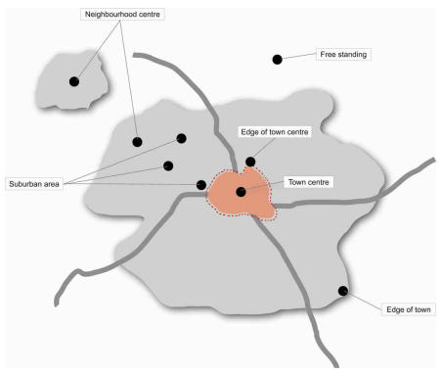
Analysis of Location Types
We can also analyse, for any given time period, the frequencies that the various land use categories are used in trip rate calculation filtering.
Notes:
We can also analyse, for any given period, the frequencies that the various land use categories are included in trip rate calculations. Of course, there are different location types that can often be used together in a calculation, and the following analysis shows the number of times that each separate main and sub location type is included in a dataset. The image on this slide is a simplified diagram of the main location type categories in TRICS, which were re-defined back in 2008.

Slide 6
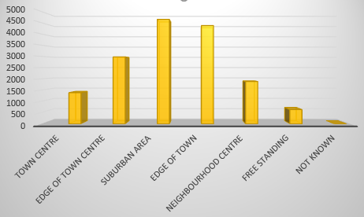
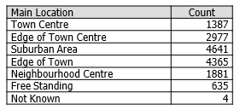
May 2017: Use of Main Location Types
Notes:
So let’s have a look at the main location types, again all based on TRICS usage in May 2017. One thing to note is that this is not an indication of preference, as in some cases certain location types may be used out of necessity given small datasets, but it does show how often the various main location types were included in datasets for calculation (covering all land use categories). As you can see, the two most often used categories are “Suburban Area” and “Edge of Town”, being used over 4,000 times each. This is followed by the “Edge of Town Centre” category. Note that because of the definition of “Edge of Town Centre” in TRICS (in that it covers a relatively small band around the centre of a town or city), the incidences of sites classified as such will be low when compared to the number of sites with, say, the “Suburban Area” category, which covers a much wider part of a town/city.

Slide 7
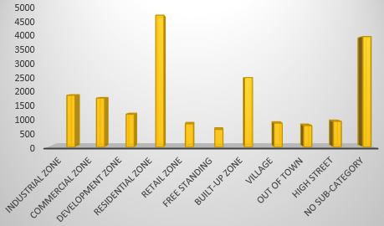
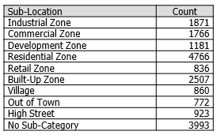
May 2017: Use of Sub Location Types
Notes:
We can also go further and examine the use of location sub-categories, as you can see here. Having been involved in the input of TRICS data for as long as I can remember now, I know that many of the sites input do fall under the “Residential Zone” category, which will be part of the reason why use of this sub-category is the highest. It should also be noted that quote a few sites don’t actually fall under any specific sub-category, and this is reflected in this chart too. Putting these two types aside, there is a reasonably good spread of use across the remaining sub-categories.

Slide 8
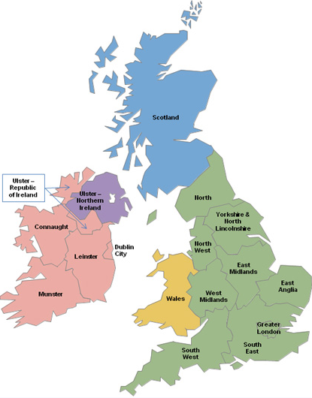
Analysis of Regions
We can also analyse, again for any selected time period, the number of times that different TRICS regions are included in trip rate calculation datasets.
Notes:
We can also have a look at an analysis of regional data use. Shown on this slide are the 17 regions of TRICS, covering the whole of the UK and Ireland. Every year we undertake a number of surveys across all of these regions, to ensure that everywhere is covered. Of course, for some regions there will be more surveys undertaken than for others, and we review this every year based on demand and a review of the existing database.

Slide 9
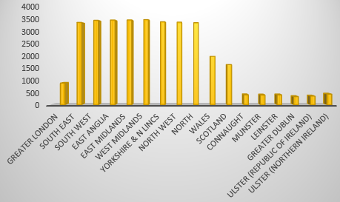
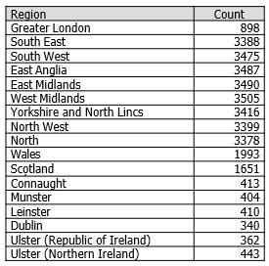
May 2017: Use of TRICS Regions
Notes:
Here is a breakdown of the number of times each of the 17 regions has been included in datasets for trip rate calculation, once again based on the use of TRICS in May 2017. The main thing standing out here is the almost equal spread of usage across all regions in England, with no particular region being used much more than the next. Then you can look at London, which many people consider a “special case”, along with Wales, Scotland, and the Irish regions. It is good to see that all of the regions are being used to various degrees, and this reassures us when we look to undertake further year-on-year data collection programmes. All of our regions are important to us.

Slide 10

Note on Regional Selection
TRICS recommends that users do not deselect by region automatically before taking into account other factors such as population levels, location types and car ownership levels etc. The TRICS Good Practice Guide provides further information.
Notes:
I do need to remind everyone about the guidance that we give on regional selection in the trip rate calculation process. This of course is contained within our regularly updated TRICS Good Practice Guide, which can be accessed from the system’s Library module or indeed when running the system itself by clicking on an ever-present icon. The main thing to say here is that TRICS recommends that users do not deselect by region automatically without first taking into account more specific factors that may influence trip rates, such as population ranges, location type, car ownership levels, etc. The Good Practice Guide goes into more detail, but we do recommend that users try an inclusive rather than an exclusive approach when considering which sites to include in the trip rate datasets.

Slide 11
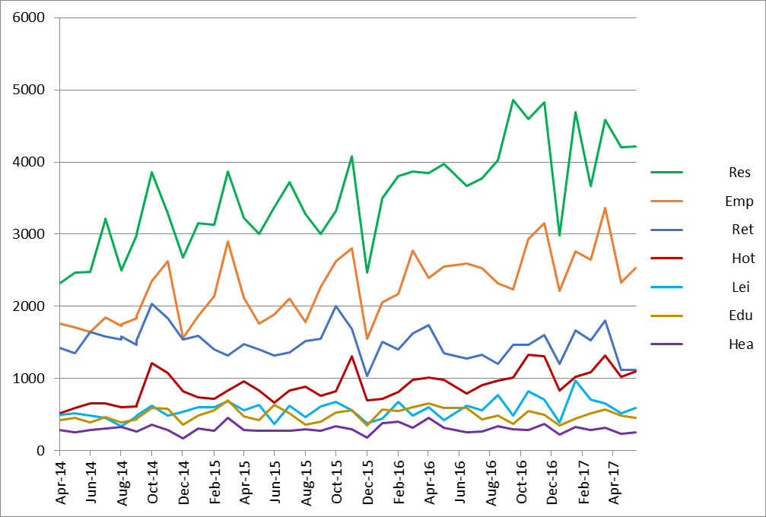
Trip Rate Calculations by Main Land Use
Notes:
Now we have quite an interesting graph, showing the number of trip rate calculations undertaken by the top seven main land use categories from 2014 up to the current date. Following the recession, which saw use of TRICS naturally drop, the “recovery” of our system can be clearly seen here. Especially for the residential main category, the number of calculations for which has increased quite significantly over the last three years. You will also see at the left side of the graph, back in 2014, we had a “top three” of residential, employment and retail. However, over time this has become more of a “top two”, with calculations for the retail category remaining rather static whilst residential and employment use has increased. The other main categories that can be seen at the bottom of the graph are education, health, hotel food & drink and leisure. We monitor changes to these trends on a month-by-month basis, and this continuous analysis assists us in determining land use types where data collection should be more focused (whilst of course making sure that we maintain a good overall coverage across the land uses).

Slide 12
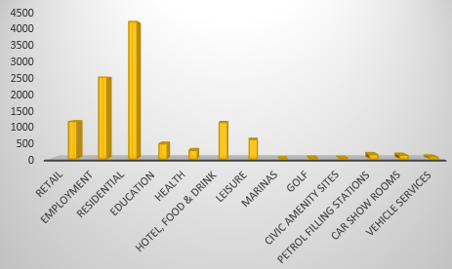
Trip Rate Calculations: May 2017
Notes:
Let’s take a look at the overall number of trip rate calculations in May 2017. As expected, the residential category dominates, followed by employment and then retail and hotel food & drink. This is probably quite a typical monthly profile over the course of the last year or so, and reinforces the need to keep residential developments surveyed and the database updated accordingly, whilst of course not ignoring the other categories.

Slide 13

Residential Trip Generation
Largest category for trip rate calculation
4,256 trip rate calculations undertaken in May 2017
Biggest growth in activity over recent years
Trend set to continue
Notes:
Looking at the use of the residential category, it is clear from our analysis that this is the largest category in terms of trip rates on the system. In May 2017, there were a total of 4,256 residential trip rate calculations undertaken by our users. It is the category that has seen the biggest growth in recent years as we have come out of the most recent recession, and going by the monthly analysis that we undertake this trend of growth is expected to continue.

Slide 14
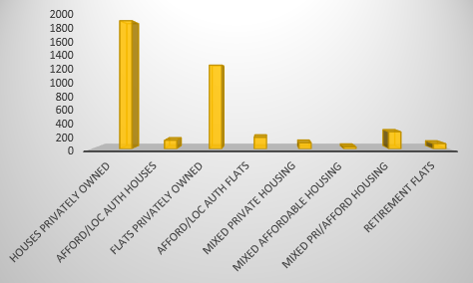
Calculations by Residential Sub Land Use: May 2017
As can be seen in the bar chart, residential trip rate calculations have been greatly dominated by the privately owned land use categories.
Notes:
We can also look at the breakdown of the residential sub land uses in terms of the number of trip rates calculated in May 2017. We can see from this bar chart that the calculations were dominated by the two main privately-owned sub categories, these being “Houses Privately Owned” and “Flats Privately Owned”. The number of calculations undertaken in the other categories such as affordable housing are much lower. This is probably not much of a surprise to anyone.

Slide 15
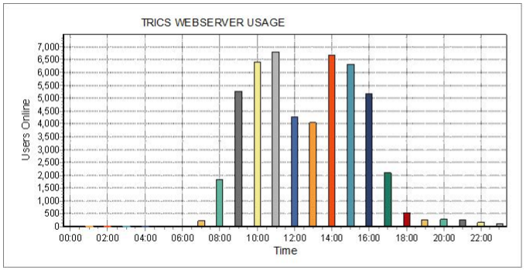
The Grander Scale: 2016 Summary
48,052 logins
Good Practice Guide accessed 2,354 times
128,296 trip rate calculations undertaken
22,739 rank order lists calculated
Notes:
We can end this presentation by looking at use of TRICS on a grander scale, an analysis of use covering the whole of 2016. There were 48,052 logins throughout the year, with the Good Practice Guide being accessed 2,354 times. There were a massive 128,296 trip rate calculations undertaken, with 22,739 rank order lists also calculated. Big numbers indeed, and a really good sign that TRICS is being used more than ever and is in a really healthy place right now.

